Slide 1
UTILITY BILL
PAYMENT SYSTEM

Slide 2
INTRODUCTION
The main purpose of Utility bill payment system is to pay the electricity and telephone bill online.
It is mainly designed in order to save the effort and time of paying the telephone as well as electricity bill for both government employees as well as public.

Slide 3
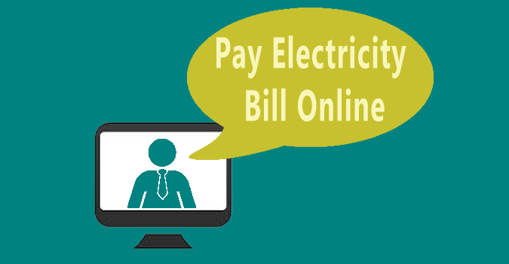
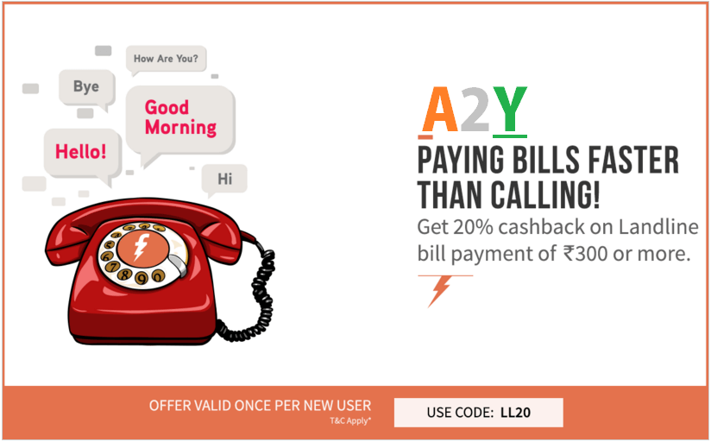
What does utility bill payment System do???

Slide 4
ADVANTAGES
Advertising: electronic inserts can be customized to the individual customer.
Reduces the customer’s expenses by eliminating the cost of checks, postage, and envelopes.
Simplifies and centralizes payment processing and facilitates better record keeping. Customers can review and pay bills at virtually any time
The reduction in expenses related to billing and processing payments

Slide 5
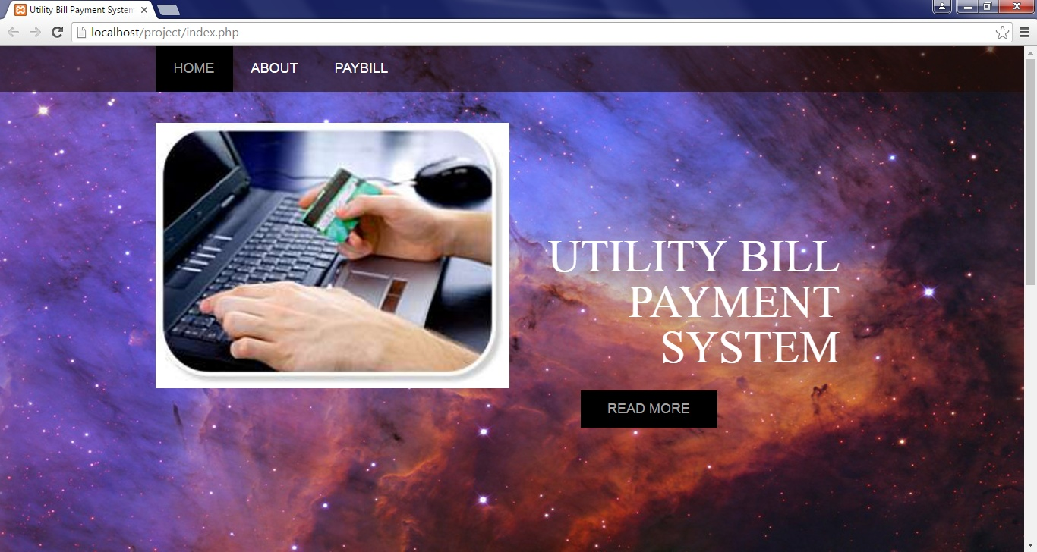
SNAPSHOTS
This screen shot explain about the flow of our project
HOME PAGE:

Slide 6
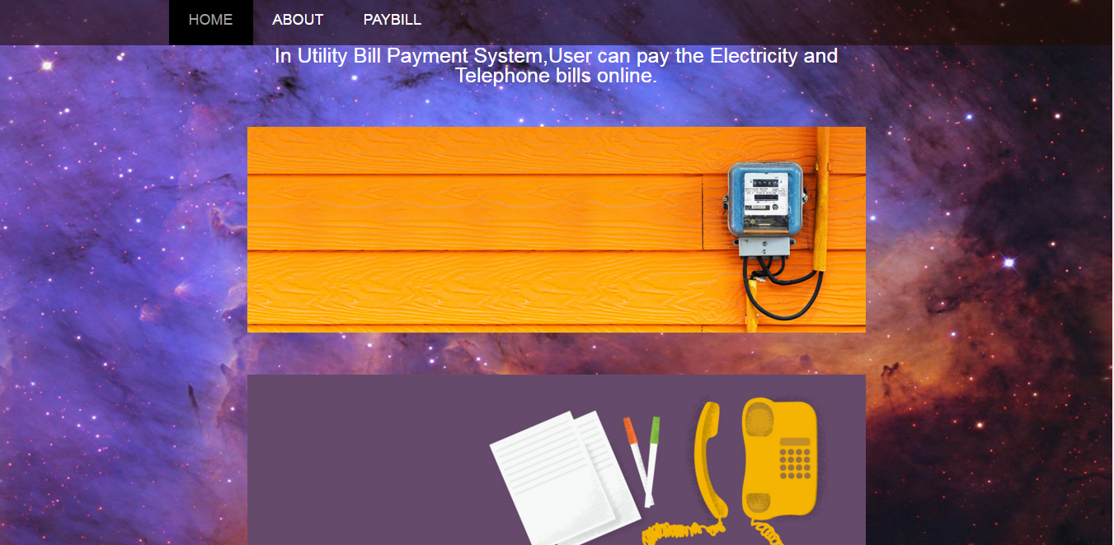
ABOUT PAGE :

Slide 7
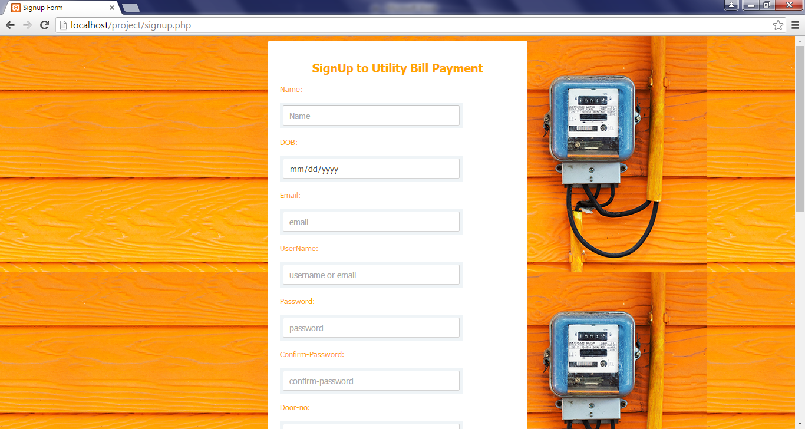
SIGNUP PAGE:

Slide 8
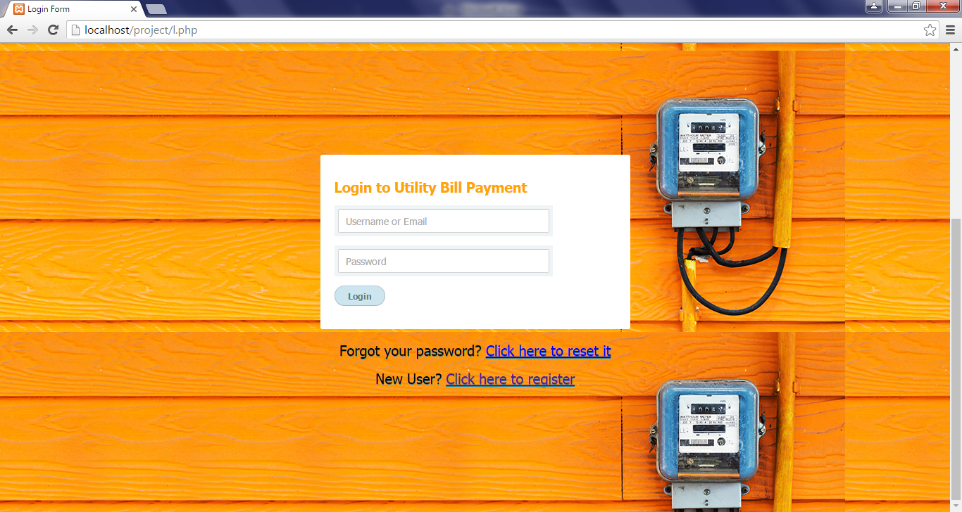
LOGIN PAGE:

Slide 9
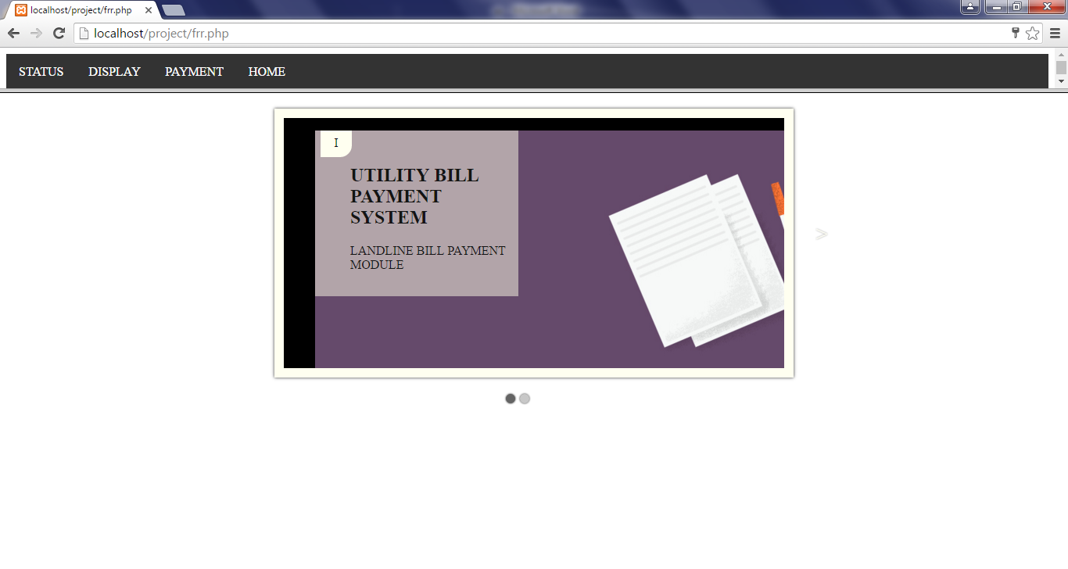
PAYMENT PAGE

Slide 10
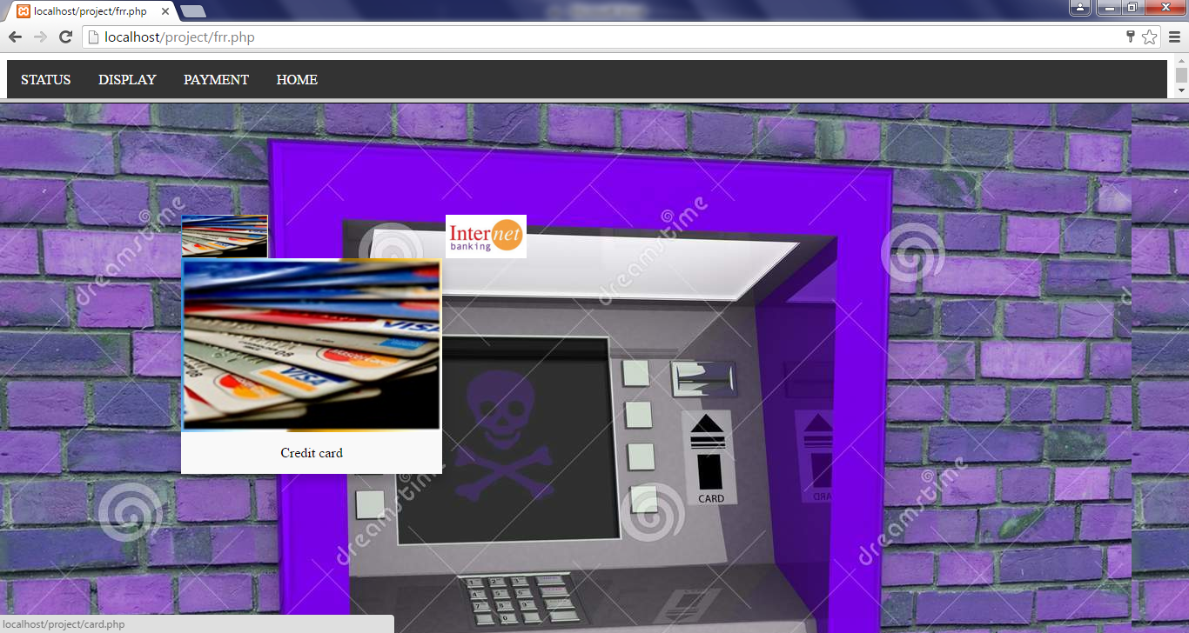
PAYMENT MODE:

Slide 11
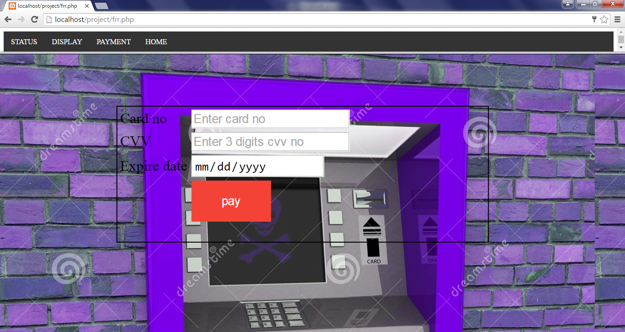
CREDIT CARD MODE:

Slide 12
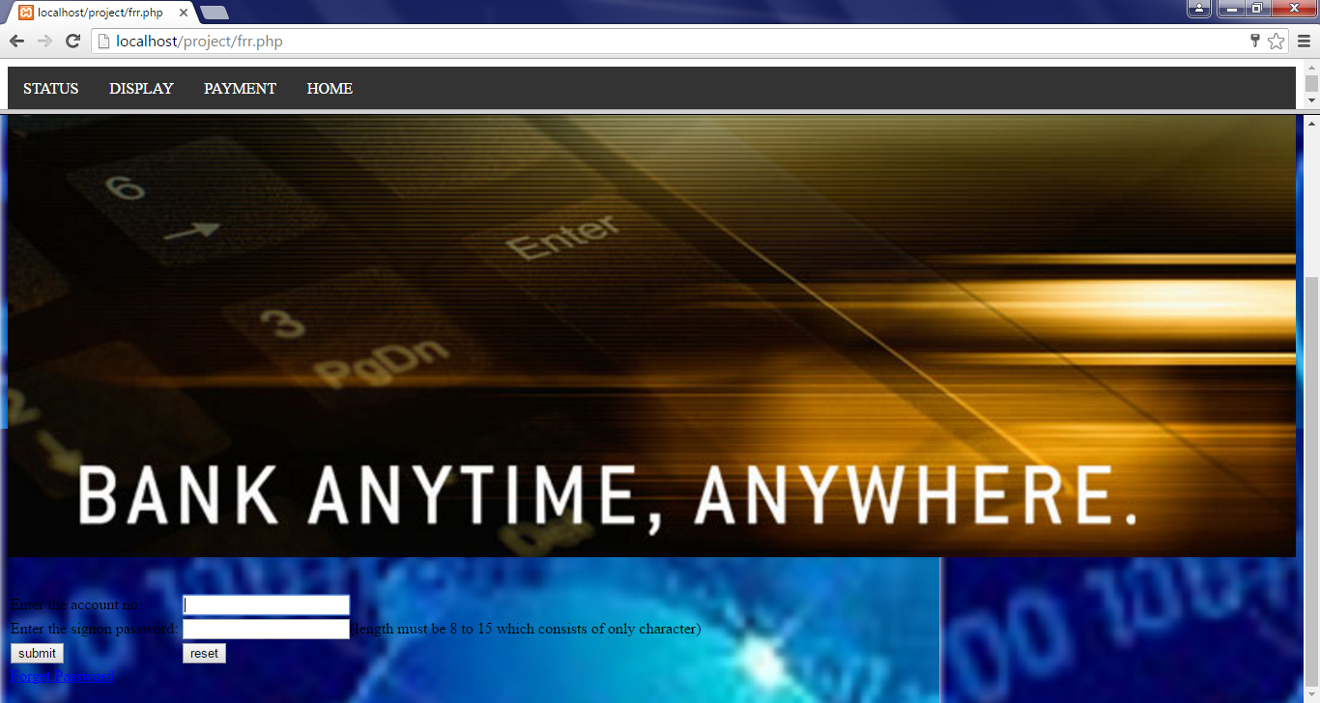
NET BANKING MODE:

Slide 13
LIMITATIONS
Due to time constraints we were unable to connect with Real time bank.
So we have use some databases for bank
The following are the table names
1.bank
2.cdetails
3. login
4.transfer

Slide 14
CONCLUSION
We have tried my best to make the complicated process of E Bill Payment system as simple as possible using structured & modular technique & menu oriented interface.
Even though we cannot claim that this work to be entirely exhaustive, the main purpose of my exercise is perform each employee’s activity in computerized way rather than manually which is time consuming.

